Slide 1
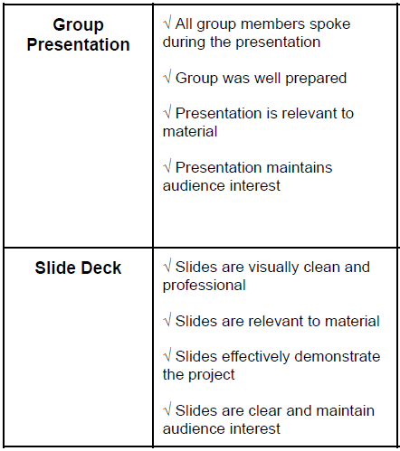
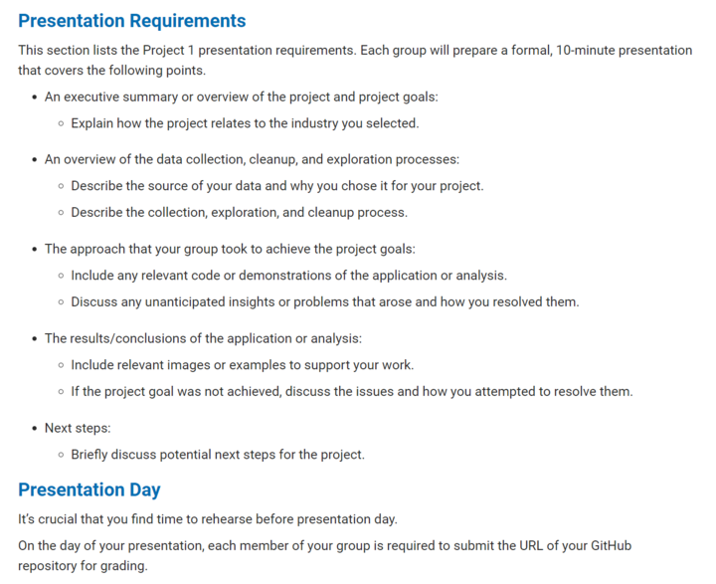
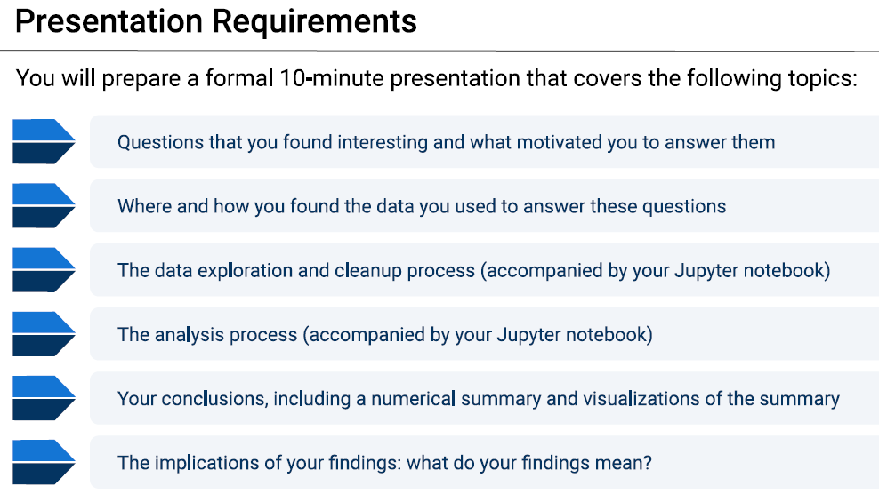
Presentation Requirements

Slide 2

Urban Real Estate Investing, U.S.
Aaron Summers, Brannan Geshwind, Cory Selzer, Dulce Silva,
Rebekah Aldrich, Tait Ralston
Notes:
Tait

Slide 3
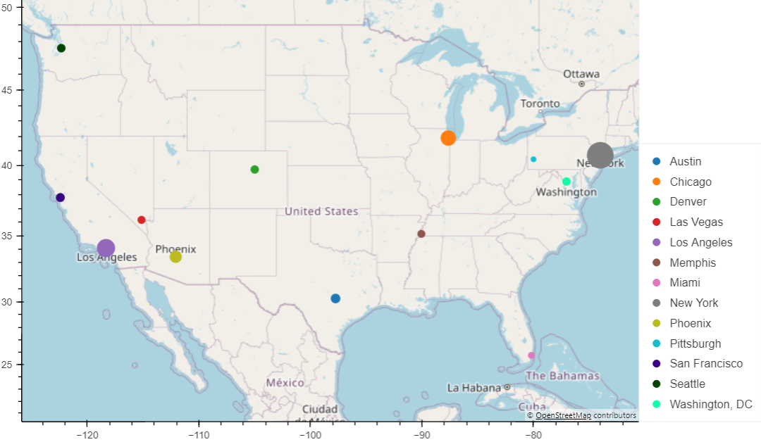
About us
We focus on real estate investing strategies within the US looking at trends across property value, property sales, population sizes, job markets, crime, schools, and other factors our clients find key to their situation
Notes:
Rebekah

Slide 4

Meet our client
BIO
Couple in early 50s with 2 fully independent children located in suburbia Tampa, FL.
Looking to invest remotely in urban/suburban properties as another source of income. As beginners, they want to focus on starter family housing and have asked us to recommend where to focus in the US.
Key care abouts
Target Cities
Housing up to 1500 sq. ft.
Housing up to 3 bedrooms
Homes, Townhomes, Condos
Evidence of population growth
Evidence of property value growth
Evidence rental prices competitive to mortgage
Austin, Chicago, Denver, Memphis, New York, San Francisco
Other Considerations
Good school districts
Low crime rates
Positive job market
Notes:
Rebekah

Slide 5
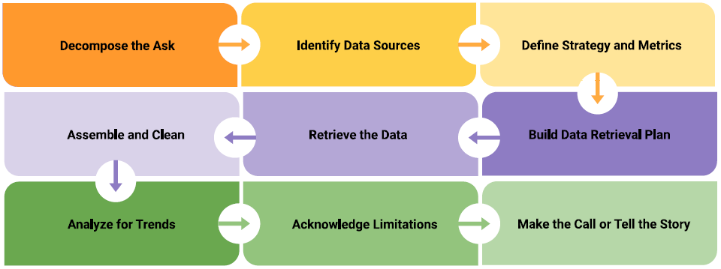
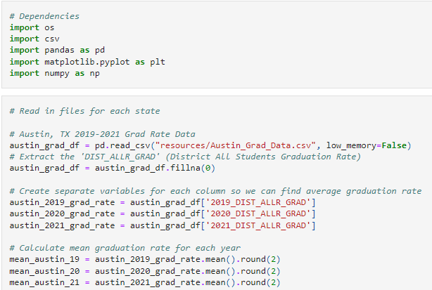
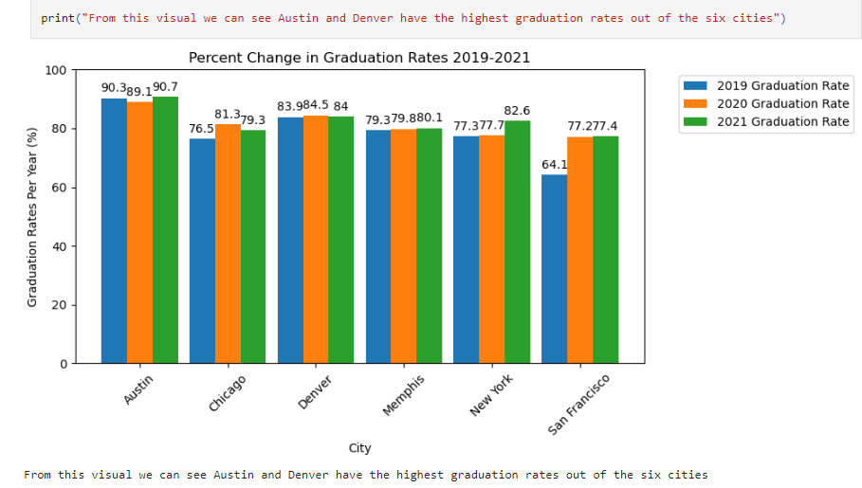
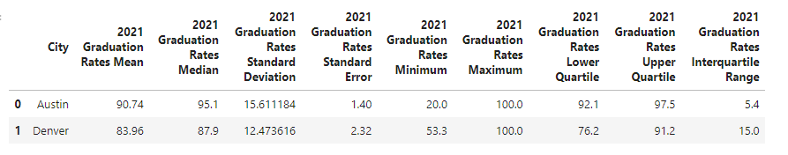
Process: School Notebook Demo
Notes:
Tait

Slide 6
Process Overview
Group: Brainstorm Project Ideas
Group: Define Ideal Asks
Individual: Prototyping by Ask
Group: Refine Ask (strategy / metrics)
Group: Brainstorm Data Sources
Group: Planning

Slide 7
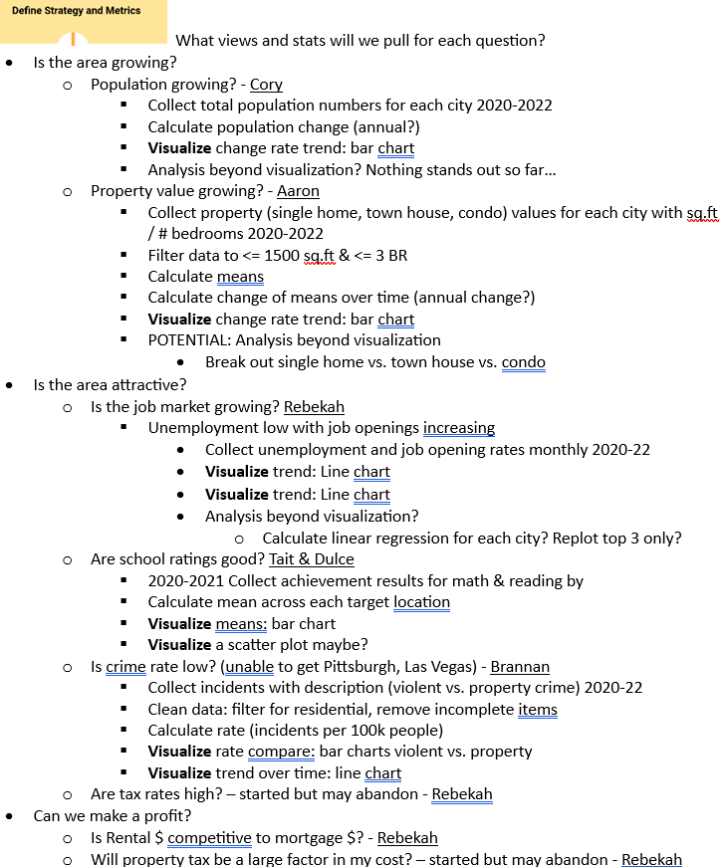
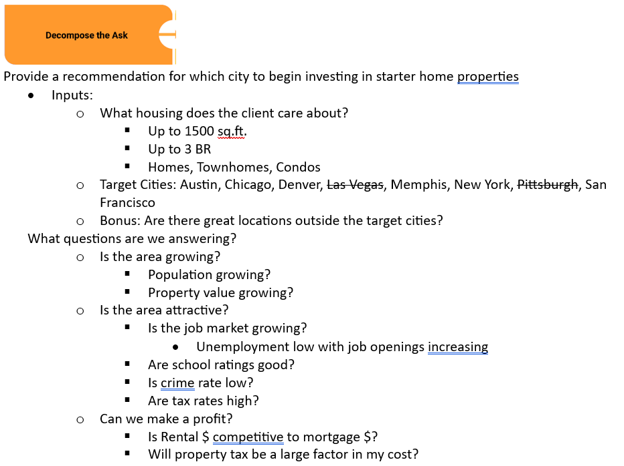
The Plan

Slide 8
Process Overview Continued
Individually/Partnering plan, gather, clean, analyze by ask
Individual/Partner: tell the story by ask
Group: Review asks as a whole
Group: Make the final call
Ask for additional support . Modifications given limitations
Group: Tell the story
Notes:
Analysis included:

Slide 9



Data Sources
Population Growth
Property Values
Census Data API
Census Data Wrapper
Used Census dependency within Jupyter Notebook. Limited dataset due to 2022 Census information being unavailable.
https://www.attomdata.com/
Used API to show house/sales in our 6 cities created Data Frames for each city Combined all cities the graph sales date by price
Profitability
Schools
Census Python API
Monthly vs. Annual data sets
Unable to limit scope for desired homes
Austin, Chicago, Denver, Memphis, New York City, San Francisco
Very descriptive education/school from each city/state found. Had to par down some of the files before importing due to spreadsheet complexity.
Crime
Job Market
Austin, Chicago, Denver, Memphis, New York City, San Francisco
Official city government data is incredibly helpful, however large file sizes and not every city has the same level of organization
U.S. Bureau of Labor Statistics API
Free registration highly recommended
Good documentation on potential calls
Inconsistent granularity on location level
Notes:
Aaron

Slide 10

Approach Highlights & Lessons Learned
Analysis Details
Lessons Learned
Working with reported rates
Know Your Limits
Collected data
Minor data cleaning
View trend over time with line chart
Use trend lines when “messy”
Use ANOVA, T tests to verify differences
How messy is data source
Inconsistent reporting
Timeliness of outside communication
Git capability
Free Data Limitations
Working with reported values
Free API call restrictions
Inconsistent timeline availability
What is available? (e.g. graduation rate vs. school rating)
Maxing out our API call limit
Collected data
Cleaned data
Calculate key care abouts (e.g. mean, change rates)
Charted means
Calculated statistics to better understand population (e.g. standard deviations / quartiles)
How Did We React?
Leverage each other on time/qty limits
Shifted timelines but kept same length
Reduced target cities
Reduced crime scope (property specific)
Notes:
Dulce – focus on Lessons Learned
Top notes:
Data gathering and cleaning can be VERY time consuming (ATTOM API restrictions, Messy crime data)
Be flexible – keep communication ongoing with your clients!

Slide 11

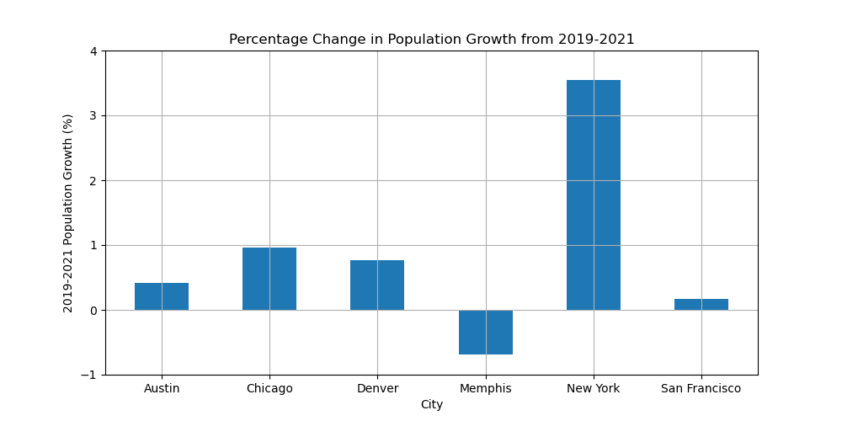
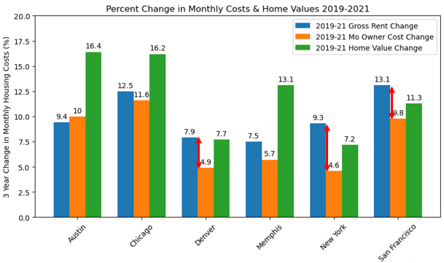
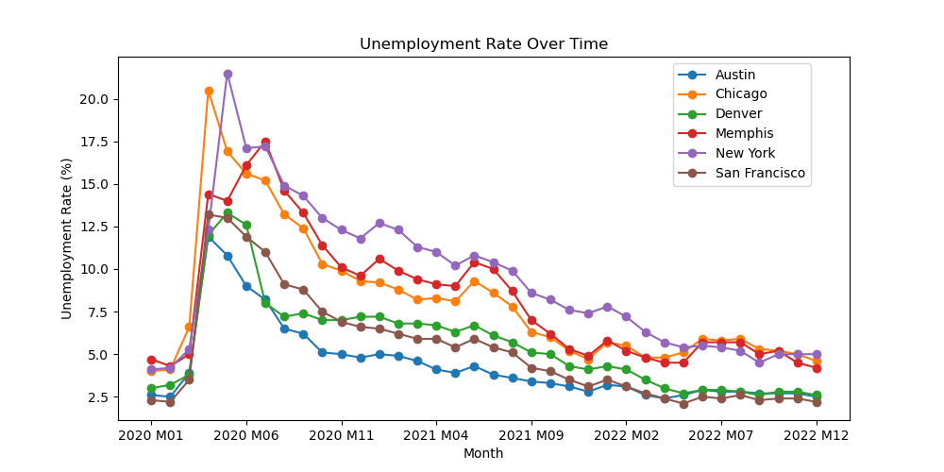
FINAL Recommendation: Denver, CO
Population Growth
Third in population growth
Profitability
Third in potential profitability growth
Attractive
Top in job market
Maybe Top in Crime Rate
Second in graduation rates
Notes:
Cory

Slide 12


Next Steps
Once have reduced target cities, further dive into specific location details(e.g. city vs. suburb; zip codes; specific schools)
Clarify Profitability
- Find mortgage + property tax costs to compare to rental for target housing
- Average time to re-coup investment money
- Long term vs. short term rental
Clarify attractiveness
- Pull property crime rate out from overall crime rate
- School performance on standardized test results
Notes:
Brannan

Slide 13
Additional Supporting Analysis

Slide 14

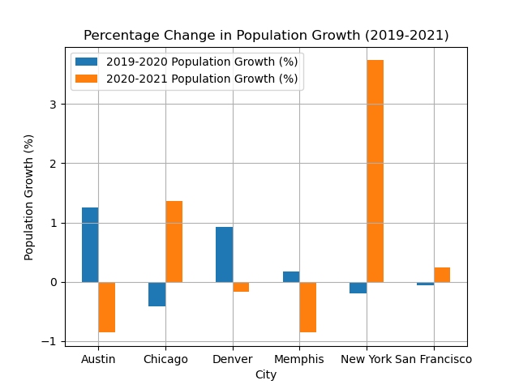
Population Analysis By growth Percentages
Sources: Census Data Wrapper, Census Data API
New York City
Shows the highest overall population growth for the years analyzed.
Chicago, Denver, Austin, san francisco
All show overall population growth in the same timeframe.
Memphis
Shows an overall decrease in population size for the years analyzed.
14

Slide 15
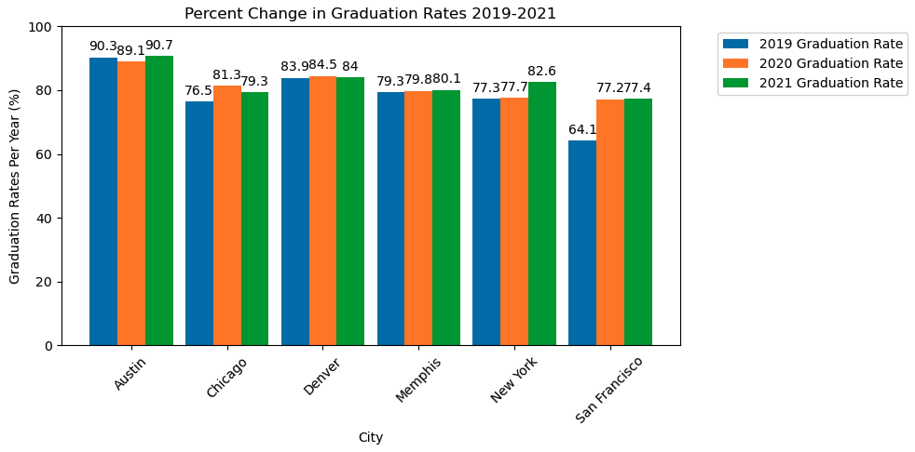
School Analysis By Graduation Rate Percentages
Sources: Austin, Chicago, Denver, Memphis, New York City, San Francisco
Austin, Denver
Show the best overall graduation rates in their schools for the analyzed years. The middle 50% of Austin schools have a graduation rate between 92.1 and 97.5. The middle 50% of Denver schools have a graduation rate between 76.2 and 91.2.
San Francisco
Show the greatest improvement in graduation rate percentage over the 3 years analyzed compared to the other cities.
Chicago, Denver
Show a decrease in graduation rate from the 2020 to 2021 school years.
15
Notes:
Tait –
As you can see in the cluster bar graph and the summary of statistical analysis, our top 2 city choices for school graduation rate percentage were Austin and Denver.

Slide 16
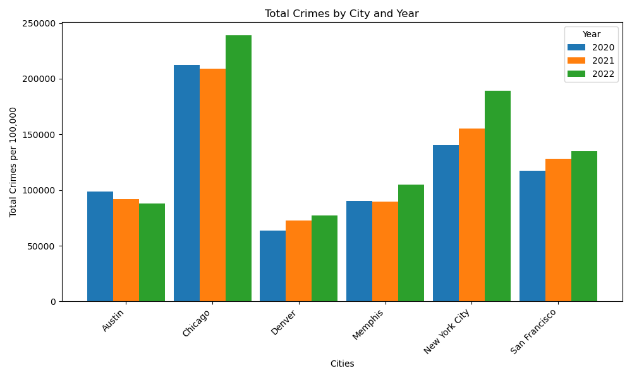
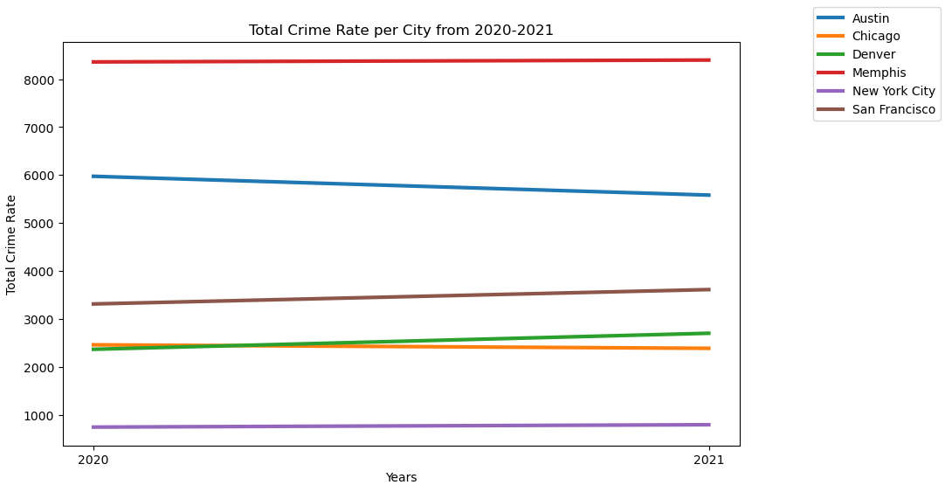
Analysis of crime in cities
Sources: Austin, Chicago, Denver, Memphis, New York City, San Francisco
Denver, Austin
The two lowest in terms of overall amount of crime. Denver, however, is showing an increase in the amount of crime over the years, whereas Austin is decreasing.
Memphis, San Francisco
Both cities are more in the middle when it comes to crime, but both show increases to crime more steeply.
Chicago, New York City
The highest amount of crime of all cities. Both show incredible amounts and increases between years.
16
Notes:
Brannan –
As you can gather from each graph, it shows that Denver has the lowest crime but rising, Austin is the next lowest and decreasing, and Memphis is third with an increasing amount in crime.

Slide 17

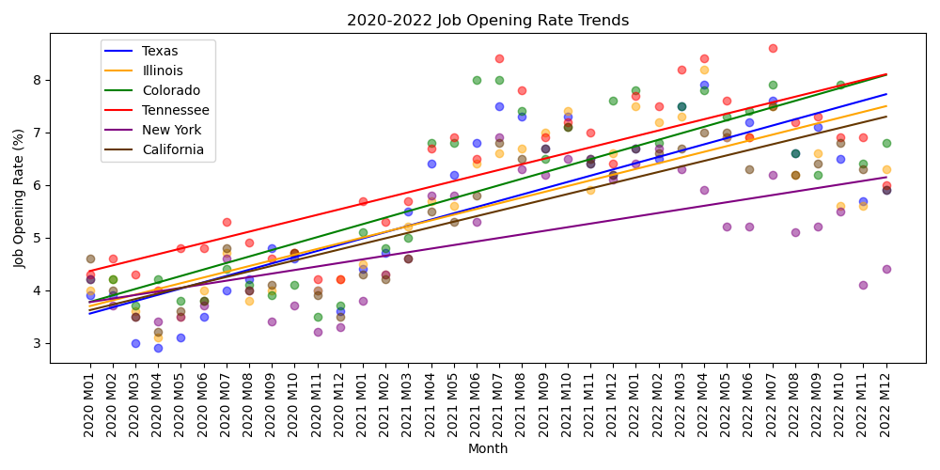
Job market trends
Source: U.S. Bureau of Labor Statistics
Denver, Colorado
Has the best overall job trend helping attract more people to the area compared to other target cities
Colorado, Tennessee, Texas
Have the highest job opening rate trends of the target states.
San Francisco, (Austin, Denver)
Have the lowest unemployment rates of the target cities.
Notes:
Other Notes:
Unemployment:
Denver, Austin, San Francisco are different (p-value: 0.178)
Denver & Austin are on the edge of being different (p-value: 0.053)
Job Openings:
Texas, Illinois, California are different (p-value: 0.854)
Texas and Illinois are different (p-value: 905)

Slide 18
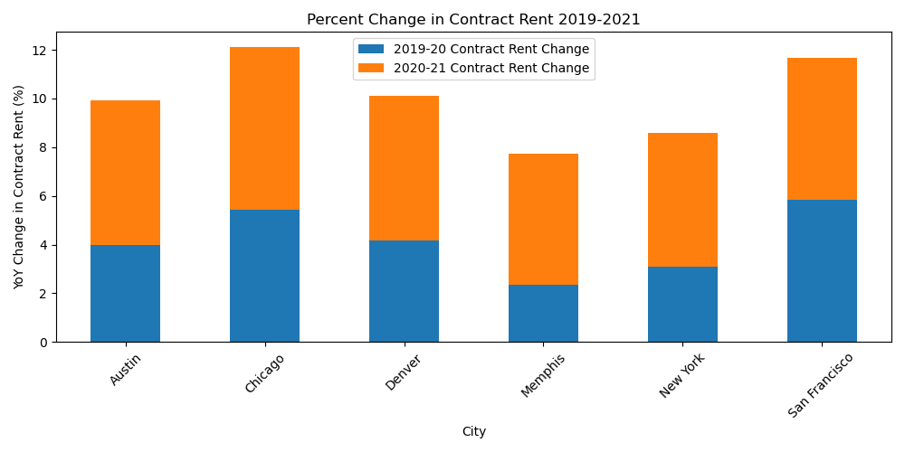
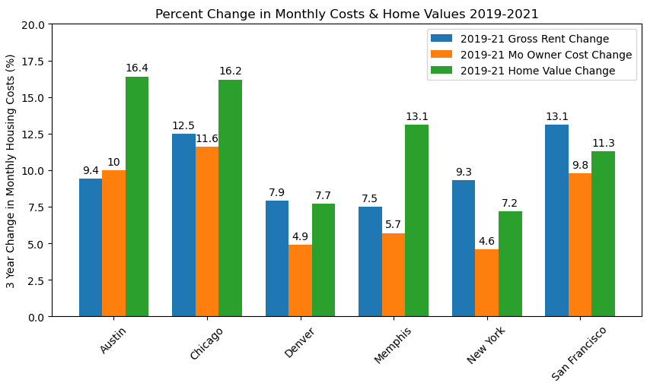
Profitability Growth
Source: Census Python API
San Francisco (Chicago, Denver)
Considering rental pricing, mortgage, and home value growth, San Francisco is the most well-rounded performer out of the target cities.
Chicago and Denver are runner ups.
Chicago, San Francisco
Show the most growth in rental prices with Austin and Denver in the next grouping.
New York, San Francisco, Denver
Show rental costs outpacing mortgage costs more than others with New York being the strongest.
Austin, Chicago
Show the most growth in home value with Memphis & San Francisco in the next highest grouping.
Notes:
https://www.census.gov/data/developers/guidance/api-user-guide.html

Slide 19
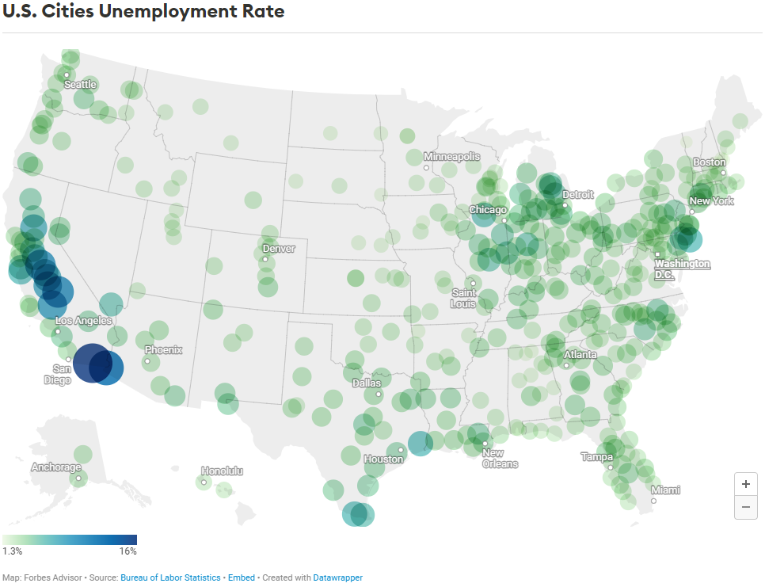
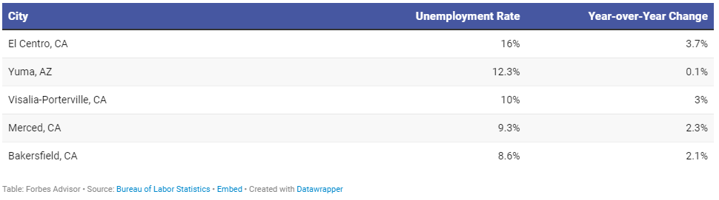
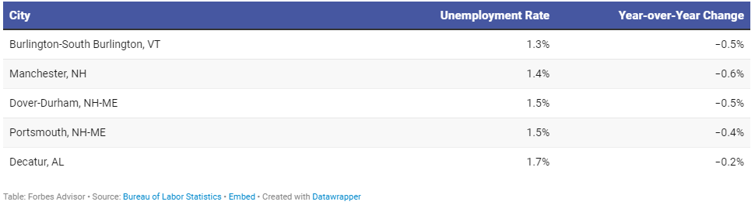
Unemployment rates across the united states
Highest Unemployment Rate
Lowest Employment Rate
Potential cities add for consideration:
Notes:
Source: https://www.forbes.com/advisor/personal-finance/unemployment-rates-by-city/#:~:text=The%20Bureau%20of%20Labor%20Statistics,Statistics%20Estimation%20Methodology%20(LAUS).

Slide 20

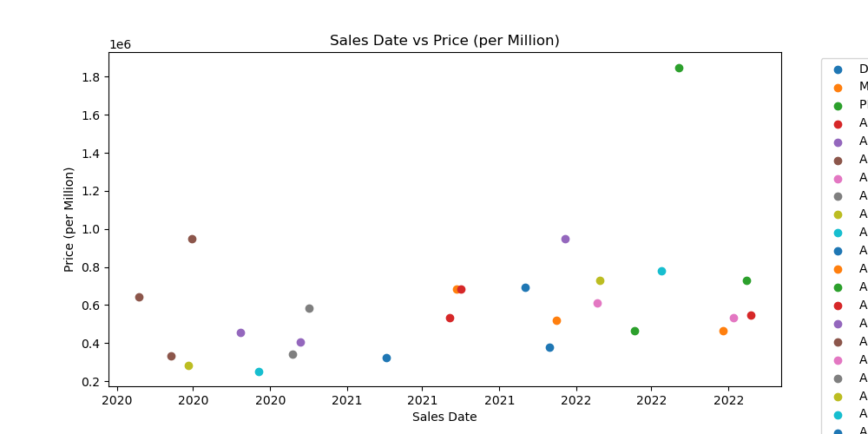


Starter Home sales trends
Optional: Sales trends
Optional: Houses Available to Buy
This chart shows the recent sales of house within our 6 cities, the houses also meet these parameters 1-3 bedrooms, square foot max of 1500 sq. ft, and zoned residential with sales in a range from 1/1/2020-12/31/2022. We Got No results for Denver, Memphis, New York, and San Francisco.
A Chart was not able to be made because there were no houses available in any of the 6 cities that we searched and also met these parameters, are houses with 1-3 bedrooms, square foot max of 1500sq. ft. , and zoned residential.

